Slide 1
Fundamentals of Deep Learning
Part 1: An Introduction to Deep Learning

Slide 2
To see lecture notes, make full screen and click the “notes” button

Slide 3
Welcome!

Slide 4
The goals of this course
Get you up and on your feet quickly
Build a foundation to tackle a deep learning project right away
We won’t cover the whole field, but we’ll get a great head start
Foundation from which to read articles, follow tutorials, take further classes
Notes:
We want to get you up and on your feet quickly, and give you the tools and theory necessary to jump into the field and tackle your own problems right away
We won’t be able to cover the whole field of deep learning, but we’ll give you a valuable set of skills and a solid understanding of how to practice deep learning today
The goal is also to prepare you to dive deeper into your learning, allowing you a foundation for reading articles, following tutorials, or taking further deep learning classes

Slide 5
Agenda
Part 1: An Introduction to Deep Learning
Part 2: How a Neural Network Trains
Part 3: Convolutional Neural Networks
Part 4: Data Augmentation and Deployment
Part 5: Pre-trained Models
Part 6: Advanced Architectures

Slide 6
Agenda – Part 1
History of AI
The Deep Learning Revolution
What is Deep Learning
How Deep Learning is Transforming the World
Overview of the Course
First Exercise

Slide 7
Have fun!
Notes:
We also want you to have fun!
There are a lot of studies that show that having fun while learning makes it a lot easier for the brain to digest new concepts. This course should not be stressful. There are coding exercises to help you solidify your learning, but we’ll provide solutions if you need them
Also, if you feel like anything didn’t fully sink in over the course of this day, you will have access to this course online for 1 year, and we’ll also be providing links to further reading to solidify your understanding.

Slide 8


Human Vs Machine Learning
Relaxed Alertness
Human | Machine
Rest and Digest | Training
Fight-or-flight | Prediction
Notes:
The technical term for learning while having fun is called “Relaxed alertness”. Our brains effectively have a gate between when we’re executing versus when we’re learning, much like how neural nets and machine learning models have “training” and “prediction” phases.
When we’re stressed out, our “Fight-or-flight” systems kick in which helps us be top performers, but that doesn’t leave a lot of resources for learning, which is a high energy process. When we’re relaxed, sure, we might not be “in the zone”, but if we’re intrigued, this is the best state for our brains to act as sponges.
https://tomprof.stanford.edu/posting/1508
One thing that’s fascinating about AI is that because it’s designed to mimic the way that humans learn, we’re going to see in action effective learning strategies. The Artificial Intelligences that we’ll be building don’t have things like “ego” or “fear of failure”, and that’s one reason why their effective learners.
At the same time there are (thankfully) many areas of learning where humans still outperform our ai counterparts. The people who capture our human ability to learn in a mathematical way are the ones who make the biggest discoveries in artificial intelligence. By working together with our robot brethren, we can learn just as much about ourselves.

Slide 9
Let’s get started
Notes:
We’re excited to have you here. Let’s get started.

Slide 10
History of ai
Notes:
Deep learning is a subset of a wider field called Artificial Intelligence. We won’t try to teach you about the whole field, but let’s start with a bit of history.

Slide 11
Beginning of Artificial intelligence
Computers are made in part to complete human tasks
Early on, generalized intelligence looked possible
Turned out to be harder than expected
Notes:
Humans have been trying to teach computers to perform tasks since their invention. It’s sort of the purpose of a computer, to do something at the level, or beyond what a human can do
Early in the days of computers, many people were convinced that they would achieve human level intelligence within a few decades
It turned out that generalized human intelligence was beyond the grasp of computers at that time (although today, we’re starting to see systems that look a whole lot like human intelligence)

Slide 12
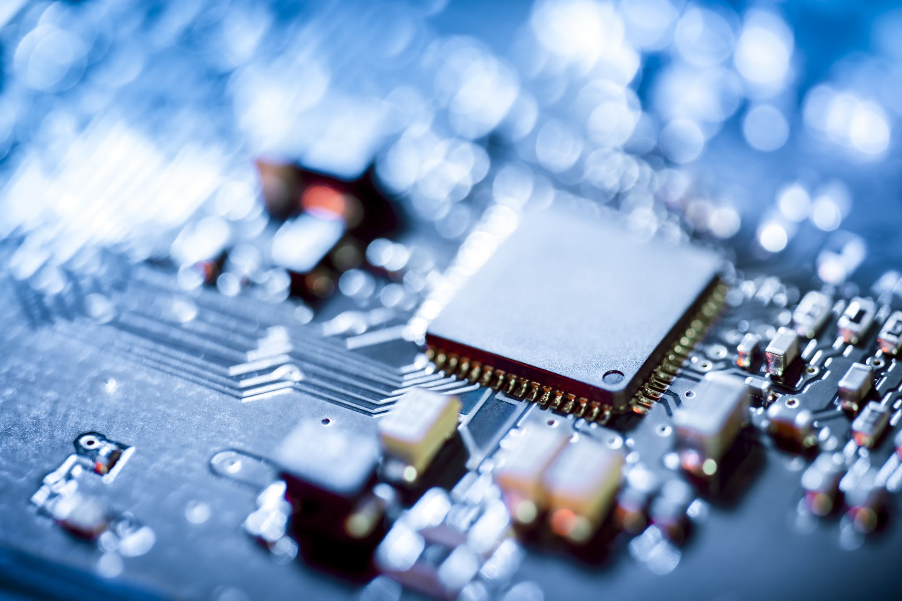
Early neural networks
Inspired by biology
Created in the 1950’s
Outclassed by Von Neumann Architecture
Notes:
It wasn’t long after the invention of the computer that people started experimenting with artificial neural networks, inspired by the structure and function of human brains
There was some success with using these networks to perform tasks such as reading handwritten digits and playing backgammon, but it did not appear that this would be the major path forward. A major factor was the computational resources at the time. As we’ll see in the hands-on labs, these networks take time to train. Imagine how long it would take to train forty years ago!
These early neural networks were outperformed by something called the Von Neumann Architecture, which is the basis for modern CPUs
https://www.cs.cornell.edu/boom/2001sp/Tsinteris/gammon.htm
https://cs.stanford.edu/people/eroberts/courses/soco/projects/neural-networks/History/history1.html
https://www.computerscience.gcse.guru/theory/von-neumann-architecture

Slide 13
Expert systems
Highly complex
Programmed by hundreds of engineers
Rigorous programming of many rules
Notes:
Instead, intelligence in computers was achieved through the building of expert systems.
https://hbr.org/1988/03/putting-expert-systems-to-work
These were highly complex systems that took hundreds to thousands of engineers to build, where the computer was taught to complete tasks by the rigorous programming of many rules
These systems where meant to mimic that of a human Subject Matter Expert, hence the name.
https://www.britannica.com/technology/expert-system
An example would be a stock trading robot that traded based on user defined limits, or a machine to give medical diagnosis given a list of symptoms.

Slide 14



Expert systems - Limitations
What are these three images?
Notes:
However these systems had limitations. Most importantly, rules for these systems had to be understood, defined, and programmed by humans. The computer could only do as much as a human engineer was able to understand and turn directly into code.
For some well-defined tasks (ex, creating a system to route customers to sales representatives based on region and vertical) this was fine. But for some tasks that are simple to humans, it was extremely difficult to build rules that a computer could follow
As an example, take a moment to answer in your head what these are pictures of (cat, car, ocean)
For most humans this is quite a simple task. But how would you teach a newborn child, let alone a computer to do what you just did?

Slide 15

How Do Children Learn?
Expose them to lots of data
Give them the “correct answer”
They will pick up the important patterns on their own
Notes:
With children, we expose them to lots of data, and help them learn by supplying the correct answer. A very popular learning technique is “Trail and Error”, where students make a prediction on what is the correct answer, and if they’re wrong, adjust their approach. It turns out that deep learning is very much like this.

Slide 16
The deep learning revolution
Notes:
So there was a period through the nineties and early 2000’s where powerful AI appeared to many to be a pipe dream
Neural networks were being used for some tasks, but fantastic results were not being achieved.
Two major things came together to spawn the era of deep learning that we’re in today

Slide 17

Data
Networks need a lot of information to learn from
The digital era and the internet has supplied that data
Notes:
The first is data. In order for a neural network to learn to understand a task, it needs to be exposed to a lot of different data. In order for a neural network to understand what a cat is, it needs to be exposed to a lot of pictures of cats, as well as a lot of pictures of things that are not cats.
The era of the internet has supplied mountains of data for networks to learn on.

Slide 18

Computing power
Need a way for our artificial “brain” to observe lots of data within a practical amount of time.
Notes:
The other major factor in the onset of modern deep learning was processing power.
If we’re effectively training an artificial brain, let’s think about our own for a second. How many gigabytes of information do we observe in a given second? What’s the “frame rate” of life? What is the resolution of the human eye?
https://www.discovery.com/science/mexapixels-in-human-eye#:~:text=According%20to%20scientist%20and%20photographer,what%20does%20this%20mean%2C%20really%3F
While modern day AI is impressive, we humans process significantly more data in a second than an AI. One way machines can try to catch up to us humans is with higher computing power.

Slide 19
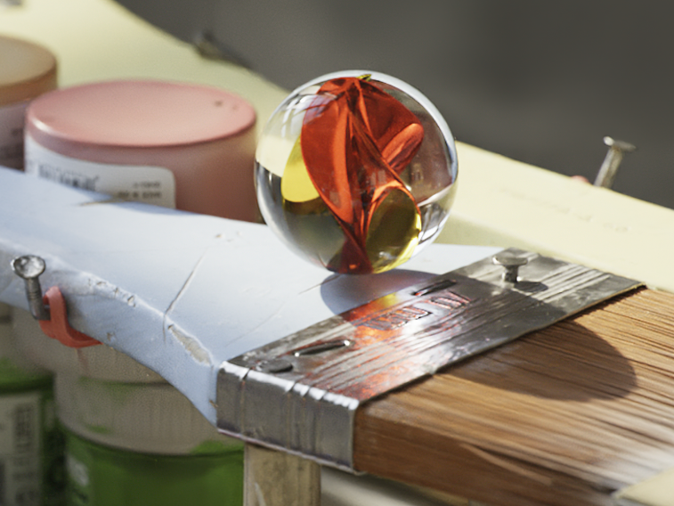
The importance of the Gpu
A Rendered Image
A Neural Network
Notes:
Left: A computer rendering of a marble: https://www.youtube.com/watch?v=H0_NZDSqR3Y&t=31s
Right: An abstraction of a neural network
It turns out that under the hood, neural networks are matrix multiplication machines. What other types of problems requires many matrix multiplications? Computer graphics! With computer graphics objects are represented as many tiny triangles working together to give the illusion of something more. With animation, simulation, and gaming, these tiny triangles are often transformed and rotated, requiring matrix manipulation.
Since neural networks and graphics are both built on top of the same fundamental mathematical problem, it’s no surprise that the hardware for one can effectively be used for the other.
An especially important invention in tackling this training was the parallel processor. The math required to train a neural network is not especially complex, but calculations must be performed (millions, billions, trillions?) of times, ideally at the same time.
Your average CPU might have 4, maybe 8 cores that allow parallel processing
However, a modern GPU, originally built for the purpose of computing the mathematics of graphics, are parallel processing juggernauts
The GPU that you will be using in this course today has (x thousand cores). These processors are incredibly well suited for deep learning, and NVIDIA is building its GPUs to be specifically architected for training.

Slide 20
What is deep learning?
Notes:
So what is Deep Learning and what makes it special?

Slide 21
Deep learning flips traditional programming on its head
Notes:
With deep learning, you flip the programming paradigm on its head

Slide 22
Traditional programming
Building a Classifier
Define a set of rules for classification
1
Program those rules into the computer
2
Feed it examples, and the program uses the rules to classify
3
Notes:
For example, normally to build a classifier, you come up with a set of rules, and program those rules
Then when you want classify things, you give it a piece of data, and the rules are used to select a category

Slide 23
Machine learning
Building a Classifier
Show model the examples with the answer of how to classify
1
Model takes guesses, we tell it if it’s right or not
2
Model learns to correctly categorize as it’s training. The system learns the rules on its own
3
Notes:
With deep learning, we first need a list of variables: inputs and their corresponding outputs. We don’t need to know the relationship between the inputs and the outputs, but the more accurate we can observe their values, the better. We’ll call this list of examples the dataset.
We then train a model by showing it the dataset and the correct outputs
The model keeps taking guesses, and finds out if it was right or not
It slowly learns to correctly categorize over the course of training
The fundamental difference is that instead of humans needing to identify and program the rules, a deep learning algorithm will learn them on its own

Slide 24
This is a fundamental shift
Notes:
This is a fundamental shift in the way we can build software systems

Slide 25
When to choose deep learning
Classic Programming
Deep Learning
If rules are clear and straightforward, often better to just program it
If rules are nuanced, complex, difficult to discern, use deep learning
Notes:
Deep learning is not always the right choice. If the decisions that need to be made to produce a result are very clear, it’s likely that it should just be programmed in the traditional way
However, if the rules are nuanced or complex, and humans would have a hard time describing them, let alone programming them, deep learning is a great choice

Slide 26
Deep Learning Compared to Other AI
Depth and complexity of networks
Up to billions of parameters (and growing)
Many layers in a model
Important for learning complex rules
Notes:
One thing that separates Deep Learning from traditional machine learning is the depth and complexity of the networks that are used. For especially complicated tasks such as natural language understanding (used for translations, text generation, other) networks can have billions of parameters.
The deep in deep learning refers to the many layers in a model that learn the important rules necessary for completing a task. These are often called hidden layers.
https://arxiv.org/ftp/arxiv/papers/1901/1901.06032.pdf

Slide 27
How deep learning is transforming the world
Notes:
Deep learning has only been a major factor in the last decade or so, but it has had huge impacts on many industries

Slide 28
Computer vision
Robotics and manufacturing
Object detection
Self driving cars
Notes:
The field of Computer Vision has been around long before the field of Deep Learning, but because there are now more and more tagged high quality images available, Deep Learning is having a large influence.
The goal of computer vision is to teach machines to see and perceive images the way that humans do. Thanks to the complexity of our eyes, not to mention the processing our brains do with these images, this is no easy task!

Slide 29
Natural language processing
Real time translation
Voice recognition
Virtual assistants
Notes:
Natural language processing, which we’ll also touch on in this course has helped make huge shifts, for example in highly accurate, real time language translation, as well as voice recognition and virtual assistants

Slide 30
Recommender systems
Content curation
Targeted advertising
Shopping recommendations
Notes:
Recommender systems based on deep learning fuel the internet with content curated feeds such as facebook, music like spotify, video like youtube and netflix, as well as targeted online advertising and shopping recommendations (Amazon)

Slide 31
Reinforcement learning
AlphaGo beats world champion in GO
AI bots beat professional videogamers
Stock Trading Robots
Notes:
Reinforcement learning has achieved incredible results in matching human expert performance, such as the AI alpha-go, which beat the world champion in what is considered one of the most difficult and complex games in the world. AI bots are now also taking on world experts in complex videogames such as Starcraft and DOTA
The list goes on, and we’ll talk about some exciting models and advancements later in the course

Slide 32
Overview of the course

Slide 33
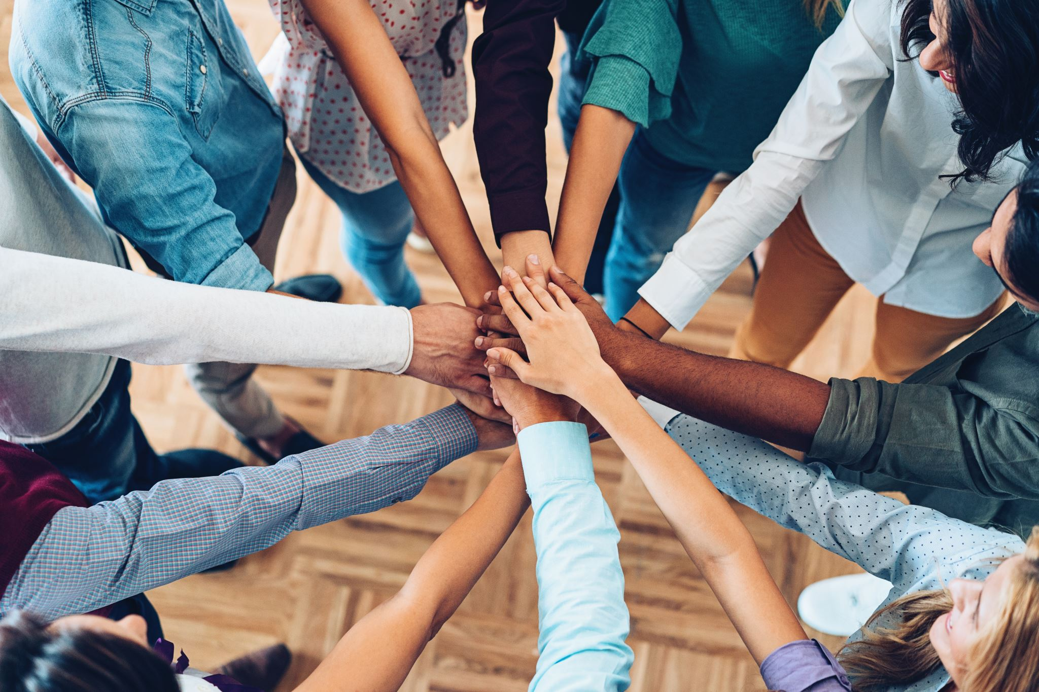
Hands on exercises
Get comfortable with the process of deep learning
Exposure to different models and datatypes
Get a jump-start to tackle your own projects
Notes:
The course is split up into a series of exercises to get you comfortable with deep learning
We’re going to be exposing you to some different models, as well as different datatypes
With only a day, we can’t expose you to everything, but the goal is to give you a significant jump-start, so that you’ll be able to have a foundation to pursue your own projects moving forward

Slide 34
Structure of the course
“Hello World” of Deep Learning
Train a more complicated model
New architectures and techniques to improve performance
Pre-trained models
Transfer learning
Notes:
Here’s the structure of the course:
- Train your first model (computer vision)
- Train a more complicated model
- Introduce new architectures and techniques to improve model performance and accuracy
- Using your trained model to make new predictions
- Using state-of-the art pre-trained models to solve a deep learning challenge
- Transfer the learning of one model to another to solve difficult deep learning challenges
- Train a language model to gain exposure to new types of data and architectures
- Appendices:
- Play around with cool models from around the web
- Learn to set up a deep learning environment to tackle your own projects

Slide 35
Platform of the course
GPU powered cloud server
JupyterLab platform
Jupyter notebooks for interactive coding
Notes:
In this course you will be connected to a server that contains a very powerful GPU.
Deep learning training is possible to run on a CPU, but due to the computational complexity of the training, it is extremely beneficial to have the massive parallel processing that GPUs provide. Without it, you would be waiting around a lot, and we could not fit this course into a single day.
You will be connected to this powerful server through a software platform called JupyterLab. Jupyter lab is a platform that among other things runs jupyter notebooks. In these notebooks you’ll be able to run and edit Python code to accomplish the goals of the exercises

Slide 36




Software of the course
Major deep learning platforms:
TensorFlow + Keras (Google)
Pytorch (Facebook)
MXNet (Apache)
We’ll be using TensorFlow and Keras
Good idea to gain exposure to others moving forward
Notes:
There are a few big players in the deep learning space when it comes to frameworks
The three most commonly used are Tensorflow + Keras (google), Pytorch (facebook), and MXNet (apache)
They are all great choices, and neither of them is a clear winner
In this course we’ll be using TensorFlow and Keras, but as you continue your deep learning journey, we recommend that you gain some exposure to the others as well

Slide 37
First exercise: Classify handwritten digits

Slide 38
Hello Neural Networks
Train a network to correctly classify handwritten digits
Historically important and difficult task for computers
Try learning like a Neural Network
Get exposed to the example, and try to figure out the rules to how it works
Notes:
Before we get too much into theory and the specifics of deep learning, we’re going to act like an AI and play with a neural network right away. See if you can figure out how we went about constructing the model. Feel free to experiment and alter the code. You can always restart the GPU instance in order to get a fresh start if your curiosity gets a little too crazy.
You’ll start by teaching a model to understand and categorize hand-written digits
Recognizing handwriting is a historically important task in the history of AI, and one that is especially well suited to deep learning
You’ll be working on a dataset called MNIST, which contains 70,000 images of handwritten digits
You might feel that there’s a lot of information to absorb in this first exercise, but be patient with yourself, and don’t worry if it’s not all perfectly clear right away. You’ll be exposed to the steps of training several times over the course, and will gain an understanding through practice
The main goal is just to give you a sense of what training looks like, and we’ll fill in some of the details as we move on

Slide 39
Let’s go!
Notes:
We’re excited to have you here. Let’s get started.

